Slide 1
Objectives
Today we will:
Fill some gaps in our Box Plot knowledge
Learn how to make comparisons using Box Plots

Slide 3
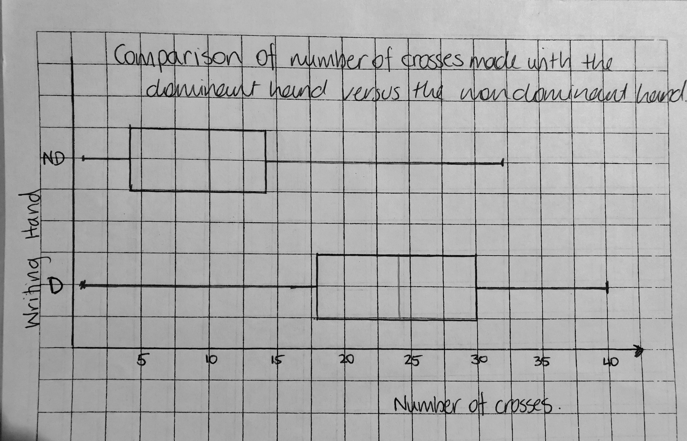
Dominant Hand Minimum: 1 Maximum: 40 Median: 24 Lower Quartile (Q₁): 18 Upper Quartile (Q₃): 30
Non Dominant Hand Minimum: 1 Maximum: 32 Median: 10 Lower Quartile (Q₁): 4 Upper Quartile (Q₃): 14
What is the difference in the position of the median between the two data sets?

Slide 4
Dominant Hand Minimum: 1 Maximum: 40 Median: 24 Lower Quartile (Q₁): 18 Upper Quartile (Q₃): 30
Non Dominant Hand Minimum: 1 Maximum: 32 Median: 10 Lower Quartile (Q₁): 4 Upper Quartile (Q₃): 14
What is the difference in the range?

Slide 5
Dominant Hand Minimum: 1 Maximum: 40 Median: 24 Lower Quartile (Q₁): 18 Upper Quartile (Q₃): 30
Non Dominant Hand Minimum: 1 Maximum: 32 Median: 10 Lower Quartile (Q₁): 4 Upper Quartile (Q₃): 14
What is the difference in the interquartile range (IQR)?

Slide 6
24
7
30
Date
Box Plots
EQ – How do I compare data sets using box plot?
Glue your “Comparing” notes page here

